Slide 1
PEPS
French Platform for Sentinel Product
SPACEOPS - May 2018
Vincent GARCIA
Notes:
GOOD MORNING LADIES AND GENTLEMEN MY NAME IS VINCENT GARCIA,
I AM THE PRODUCTION MANAGER OF PEPS WICH IS THE FRENCH PLATFORM FOR SENTINEL PRODUCT
TODAY YOU WILL DISCOVER THE BESTS FEATURES OF PEPS
I WILL BE HAPPY TO ANSWER ANY QUESTION YOU MAY HAVE AT THE END OF THE PRESENTATION

Slide 2
PEPS is the French Platform for Usage and distribution of Sentinel products : S1, S2 and S3
SPACEOPS – 31 May 2018
Notes:
LET’S BEGIN WITH A BRIEF OVERVIEW OF THE CONTEXT OF PEPS
COPERNICUS PROGRAM FORMALLY KNOWN AS GMES IS COMPOSED OF 7 DIFFERENT FAMILIES OF EARTH OBSERVATION SATELLITES
THESE SATELLITES FOCUS ON ATMOSPHERE MONITORING, CLIMATE CHANGE, SECURITY, MARINE AND LAND MONITORING, EMERGENCY MANAGEMENT
ESA AND ITS SUBCONTRACTORS MANAGE THE SATELLITES AND THE HUGE PRODUCTION OF DAILY ACQUIRED DATA.
STATE MEMBERS COOPERATE TO REDISTRIBUTE THE DATA. THERE ARE ALSO INTERNATIONAL AGREEMENT , FROM DIFFERENT INSTITUTIONS WITH ESA
PEPS COMES UNDER THIS COOPERATION

Slide 3
Features of PEPS
SPACEOPS – 31 May 2018
PEPS opened in September 2015
Free to access, free to use
For public entities (university, research, …) and private entities (start-up, …)
Develop added value and services
Notes:
PEPS OPENED IN SEPTEMBER 2015 … AND WAS AMONGST THE FIRST WEBSITE TO REDISTRIBUTE THE DATA
PEPS IS FREE TO ACCESS AND FREE TO USE
YOUR ONLY OBLIGATION IS TO AGREE TO THE ESA LICENCE
AND IF YOU REDISTRIBUTE THE PRODUCTS YOU HAVE TO INFORM THAT THE SOURCE OF THE DATA IS COPERNICUS SENTINEL DATA
THE AIM OF COPERNICUS AND PEPS IS TO DEVELOP ADDED VALUE AND SERVICES
WE OFFER FACILITIES TO INCUBATE PRIVATE ENTITIES AND SUPPORT THEM TO INVENT NEW SERVICES

Slide 4
Characteristics of Sentinel
SPACEOPS – 31 May 2018
Family | Instrument | Unit | Revisit | From
 | C band SAR | A + B | 6 days | September 2014
 | Multi Spectral Instrument | A + B | 5 days | August 2015
 | OLCI SLSTR SRAL MWR | A +B | 2 days | October 2016
Notes:
NOW LET’S TAKE A LOOK AT THE SENTINEL SATELLITE CHARACTERISTICS
NOT ONLY DOES SENTINEL HAVE MULTIPLE SENSORS, THEY ALSO PROVIDE AN HIGH REVISIT RATE.
THE SUCCESSION OF UNIT A AND B ARE UNDER CONSTRUCTION? WHICH GARANTIES THE ACTIVITY FOR YEARS TO COME.
THE FIRST, S1 LAUNCHED IN 2014 WAS A SINGLE RADAR INSTRUMENT PROVIDING 6 DAYS REVISIT,
THIS WAS CLOSELY FOLLOWED BY S2 IN 2015 CARRYING A MULTI SPECTRAL OPTICAL INSTRUMENT WITH 5 DAYS REVISIT ONLY.
AND THE LAST NUMBER OF THE SENTINEL FAMILY WAS LAUNCHED IN 2016 CARRIES 4 SPECIFIC INSTRUMENTS REDUCING THE REVISIT DELAY BY HALF.
ALL THE DATA ACQUIRED BY THESE 3 SENTINEL SATELLITES ARE AVAILABLE IN PEPS EXCEPT FOR SENTINEL 3 SOME MARINE PRODUCTS ARE GENERATED AND DISTRIBUTED DIRECTLY BY EUMETSAT

Slide 5
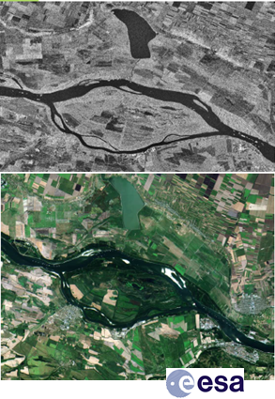
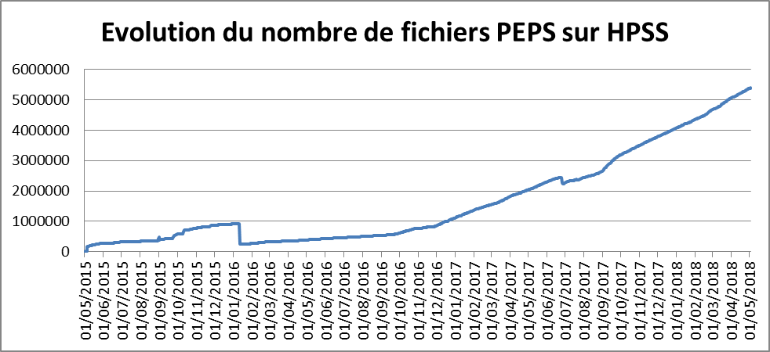
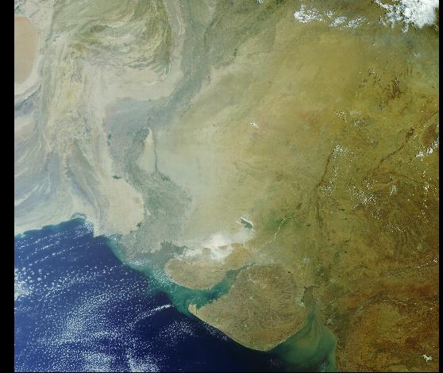
The Archive
SPACEOPS – 31 May 2018
6 Million products : + 5 Petabytes
13 Terabytes / day
2015
2016
2017
Danube S1 et S2
India S3
Notes:
OUR ARCHIVE IS A BIG DATA CHALLENGE WITH 6 MILLIONS PRODUCTS AND +5 Petabytes OF STORAGE
AS YOU CAN IMAGINE IT’S A HUGE CHALLENGE TO OBTAIN, STORED, REDISTRIBUTE THE DATA TO OUR USERS
THE AMOUNT OF DATA PRODUCED PER DAY INCREASE RAPIDLY BECAUSE OF THE ADDITION OF OPERATIONNAL SATELLITE AND THE PRODUCTS PRODUCED BY ESA GROUND SEGMENT
MORE THAN 13 Terabytes OF DATA /DAY IS DISTRIBUTED THROUGH THE ESA OPENDATAHUB WEBSITE
IT TAKES LESS THAN 1 DAY TO COPY THE PRODUCTS IN PEPS IN MOST CASES
ON THE RIGHT THERE ARE 2 IMAGES OF THE SAME PLACE FROM S1 AND S2, COMBINING DATA FROM DIFFERENT INTRUMENT GIVE THE USERS THE ABILITY TO DETECT MORE THINGS
AT THE BOTTOM RIGHT THIS IMAGE WAS TAKEN BY THE ONE OF THE S3 INSTRUMENT, THE OLCI instrument HAVE A SWATH OF 1 200 KM [SWOTH]

Slide 6
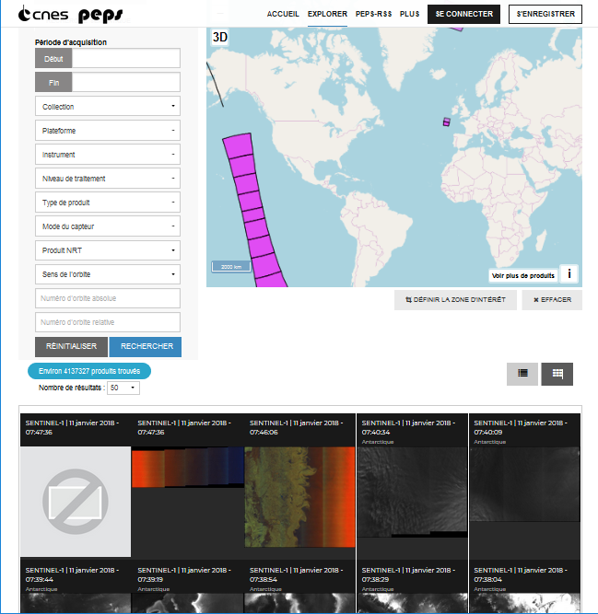
Catalog
SPACEOPS – 31 May 2018
Search
Visualize
Download
https://peps.cnes.fr
Notes:
THE CATALOG AND THE WEB USER INTERFACE IS NOT THE SAME AS THE ONE PROVIDED BY ESA
WE USE RESTO, A SOFTWARE TO MANAGE EARTH OBSERVATION DATA, WITH SEARCH, VISUALIZATION AND DOWNLOAD FEATURES. DEVELOPPED BY A CNES ENGINEER.
WITH BASIC BUT ROBUSTS FEATURES, RESTO IS USER FRIENDLY BOTH FOR PROFESSIONNAL AND NEWBIES
WE MADE THIS CHOICE TO VALORIZE THE USAGE OF SPATIAL DATA AND TO ALLOW IT TO BE MORE ACCESSIBLE TO A MUCH LARGER COMMUNITY
THE MOSTS IMPORTANT FEATURES OF THE CATALOG ARE :
SEARCH
VISUALISATION
DOWNLOAD

Slide 7
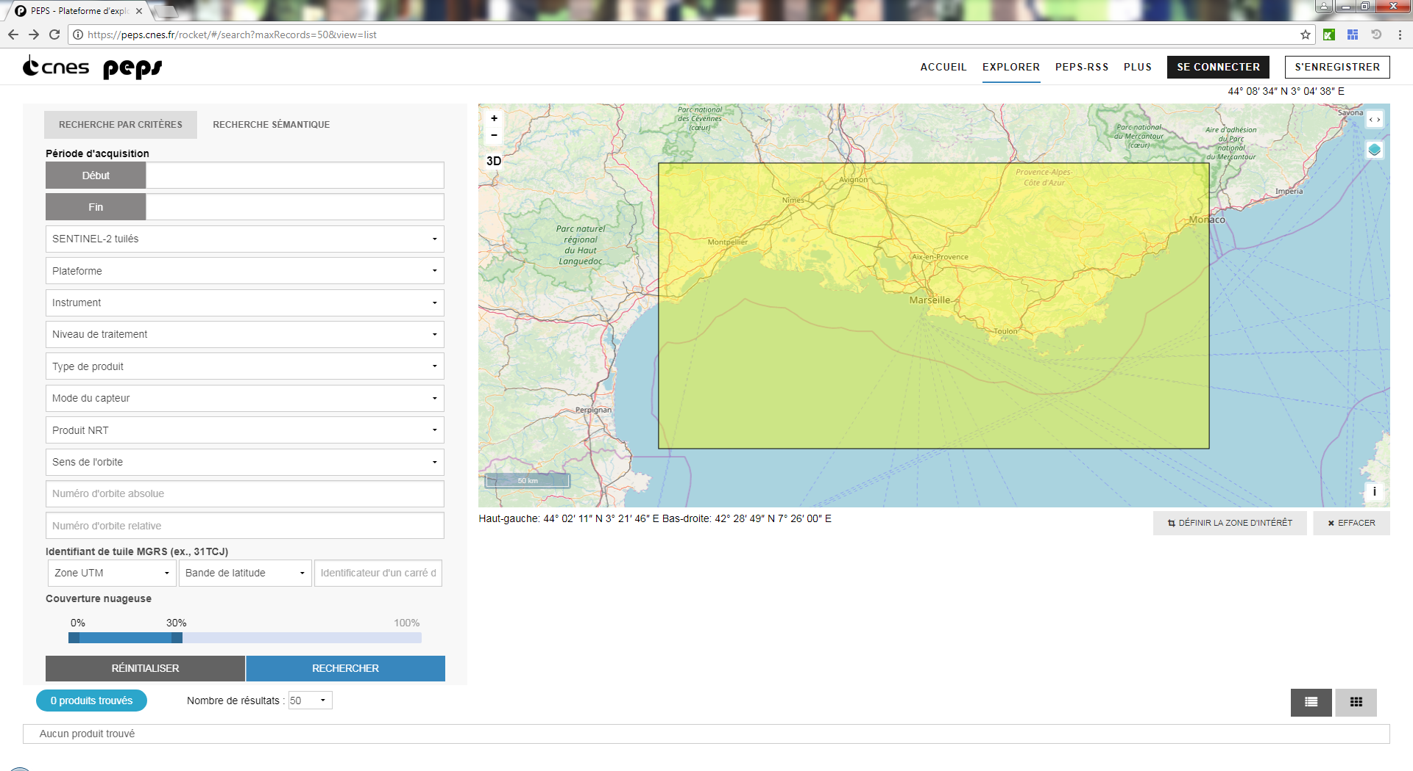
Search
SPACEOPS – 31 May 2018
Notes:
LET ’S TAKE A LOOK AT HOW IT WORKS
THE CRITERIA SEARCH ALLOWS YOU TO SELECT SOME SPECIFIC METADATA, HERE THE LOCATION WITH A GEOBOX ON THE MAP.
I HAVE SELECTED OUR BEAUTIFUL CITY OF MARSEILLE
NEXT THE COLLECTION : I HAVE CHOOSEN SENTINEL-2
AND HERE SET A RANGE OF CLOUD COVERAGE PERCENTAGE IN THE PRODUCTS, I HAVE CHOOSEN LESS THAN 30 PERCENT
PEPS OFFERS MANY OTHERS OPTIONS MORE DEDICATED TO ADVANCED USERS.
ONE OF THE KEY FEATURES THE OPENSEARCH API ALLOWING MACHINE TO MACHINE COMMUNICATION ,
IN THIS CASE YOU CAN CONNECT THE PEPS DATABASE TO YOUR SPECIFIC SOFTWARE PROVIDING AUTOMATIC UPDATES OF TAGGED DATA.

Slide 8
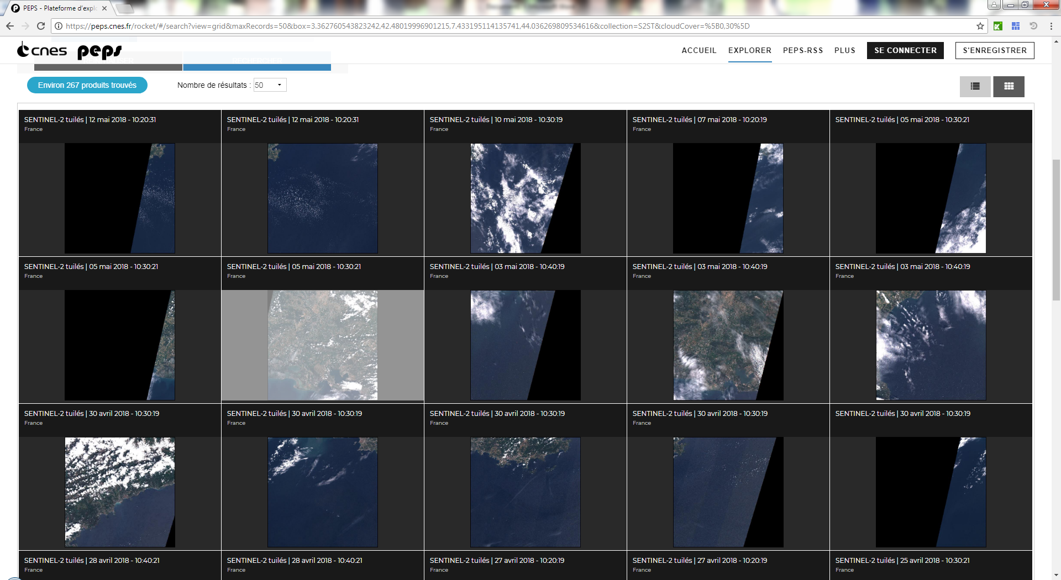
Search results
SPACEOPS – 31 May 2018
Notes:
FROM OUR RESEARCH, IN ONE CLICK WE CAN VIEW THE RESULTS
THIS SPECIFIC RESULT PROVIDES US 300 PRODUCTS MATCHING OUR CRITERIA SEARCH
WE HAVE 2 OPTIONS :
EITHER CHOOSE FILE BY FILE
OR SELECT ONE PRODUCT TO VIEW SPECIFIC METADATA
AROUND 300 PRODUCTS MATCHED THE CRITERIA CHOOSEN , I CAN CHOOSE FILE BY FILE OR ALL AND PUTT THE PRODUCTS INTO A BASKET
OR I WILL SELECT ONE PRODUCT TO VIEW SPECIFIC METADATA

Slide 9
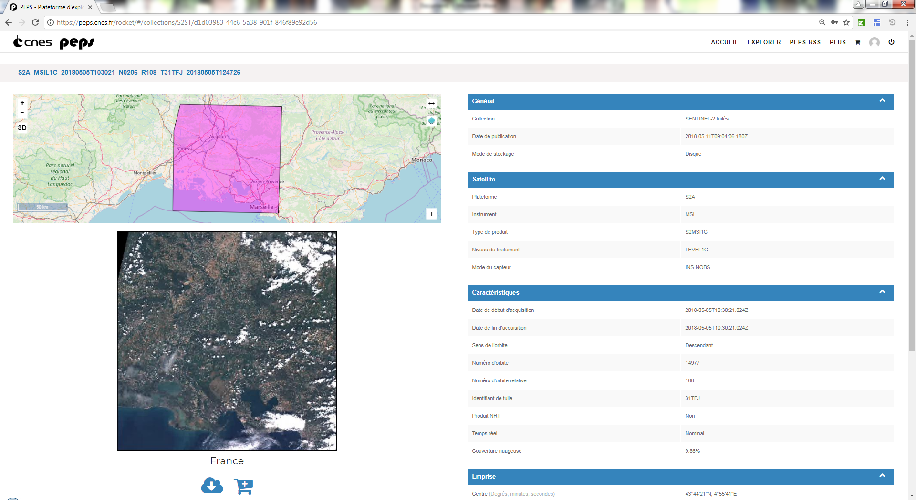
Visualize and download
SPACEOPS – 31 May 2018
Notes:
IN ADVANCED VIEW MODE
WE CAN SEE THE QUICKLOOK AND THE FOOTPRINT ON THE MAP ABOVE
ON THE RIGHT WE CAN SEE THE METADATA ASSOCIATED WITH THE PRODUCT : THE ORBIT NUMBER, THE TILE IDENTIFIER BECAUSE SENTINEL PRODUCTS ARE CROPPED ON THE MGRS GRID
UNDER THE QUICKLOOK TWO BUTTONS :
THE DIRECT DOWNLOAD
THE BASKET BUTTON, YOU CAN ADD PRODUCTS INTO THE BASKET AND DOWNLOAD LATER ALL THE PRODUCTS SELECTED
ALSO YOU HAVE THE PLUS PAGE, IT IS A FAQ PAGE YOU CAN FIND A LOT OF INFORMATION IN FRENCH.

Slide 10
Users statistics
SPACEOPS – 31 May 2018
Notes:
LET’S TAKE A LOOK AT THE SUCCESS OF PEPS
HERE WE CAN SEE THE NUMBER OF USERS OVER THE LAST 12 MONTH PERIOD
THE NUMBER OF USERS HAS INCREASED CONTINOUSLY BY 100 USERS A MONTH
IN MARCH AND APRIL 2017, THE NUMBER HAS INCREASED BY 300 USERS PER MONTH, THIS SUCCESS IS CLEARLY DUE TO WORD OF MOUTH ADVERTISING DUE TO EXCELLENT PERFORMANCES OF PEPS. USERS SPREAD THE WORD.
WE HAVE IDENTIFIED CLEARLY 4 PROFILES OF USERS :
THE FIRST NOT SO SURPRISING THE RESEARCH COMMUNITY,
30% OF THE USERS ARE DIFFICULT TO IDENTIFY
15 % COME FROM DIFFERENT EDUCATIONNAL INSTITUTION
AND FINALLY 7% OF OUR USERS USE PEPS FOR BUSINESS PURPOSES
WE ARE QUITE PROUD OF THIS RESULT AS ONE OF THE KEY AIM OF PEPS IS TO DEVELOP NEW BUSINNES OPPORTUNITIES USING SPATIAL DATA

Slide 11
Near Data Processing
SPACEOPS – 31 May 2018
PEPS provide online processing facilities
Applications are provided by CNES or by users
This feature simplify the discovery and the use of the information in the spatial data
Notes:
NOT ONLY DOES PEPS PROVIDE THE DATA WE ALSO PROVIDE AN ONLINE PROCESSING FACILITY TO HELP THE USER OBTAIN THE NECESSARY INFORMATION FROM THE DATA
THE CNES ALSO PROVIDES APPLICATION, AND USERS CAN CONTRIBUE TOO, AND SHARED THEIR APPLICATION TO THE COMMUNITY
WITH SIMPLE PROCESSING ALGORITHM THE RESULTS ARE AVAILABLE IN LESS THAN 2 MINUTES ON THE WEBSITE

Slide 12
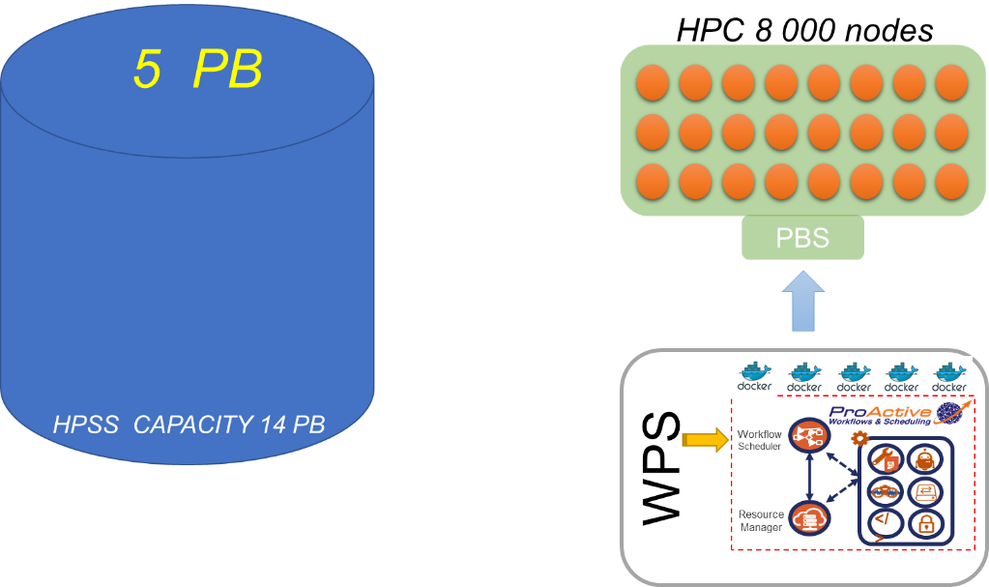
User uptake and Incubation
SPACEOPS – 31 May 2018
After agreement, PEPS host companies who want to develop and improve a spatial service
The hosting infrastructure is based on WPS, DOCKER and PROACTIVE meta scheduler
The data are stored close to the HPC
Notes:
SOMETIMES USERS/COMPANIES NEED TO PROCESS A VERY LARGE AMOUNT OF DATA
AFTER AN AGREEMENT, THE COMPANY CAN USE THE HOSTING INFRASTRUCTURE COMPOSED BY THE PEPS ARCHIVE LOCATED CLOSE TO THE HIGH PERFORMANCE COMPUTING CLUSTER
WE STANDARD SOFTWARE WPS AND DOCKER ON THE HOSTING INFRASTRUCTURE AND A META SCHEDULER NAMED PROACTIVE
PEPS GIVES THE POSSIBILITY OF SIMULTANOUSLY PROCESS A LARGE QUANTITY OF DATA
THIS THE BEST VALUABLE SERVICE PROVIDED BY PEPS, WE ALSO PROVIDE THE TECHNICAL AND THEMATICAL SUPPORT IF NECESSARY

Slide 13
Incubation service feedback
SPACEOPS – 31 May 2018
4 companies are hosted on CNES facilities
They develop, qualify, improve their service
Operationnal mode on the ESA DIAS infrastructure
Notes:
WE HOST 4 COMPANIES ON THE CNES INFRASTRUCTURE
BY USING OUR FACILITIES THEY HAVE DEVELOPED, QUALIFIED AND IMPROVE THEIR SERVICES
FROM THIS SUCCES THE CNES WANTS TO HOST AND HELP MORE COMPANIES IN THE FUTURE
WHEN THE COMPANY REACHES A CERTAIN LEVEL OF MATURITY
THEY WILL BE TRANSFERED FROM THE CNES HOSTING TO THE ESA DIAS INFRASTRUCTURE.

Slide 14
Notes:
NOW I WOULD LIKE TO SHOW WITH YOU THE SUCCESS STORY OF ONE OF THE COMPANIES WE ARE CURENTLY HOSTING EXWEXS
EXWEXS IS A COMPANY SPECIALIZING IN THE EXTREME WEATHER FORECAST
THEY USE MSG DATA AND SENTINEL 1
THEY COMBINE THE INFORMATION AND THEY MAKE 24H PREDICTION ON SPECIFIC AREA

Slide 15
Notes:
EXWEX WON SOME INNOVATION PRIZE,
THEY ARE WORKING FOR COMPANIES IN PETROL INDUSTRY OR LAST FOR YEAR THE TEAM WHO WON THE AMERICAS CUP
THEY HAVE MADE SCIENTIFIC PUBLICATION AND THERE IS A PATENT FOR THIS TECHNOLOGY

Slide 16
Feel free to contact me : Vincent.garcia@cnes.fr
PEPS support : exppeps@cnes.fr

